Slide 1
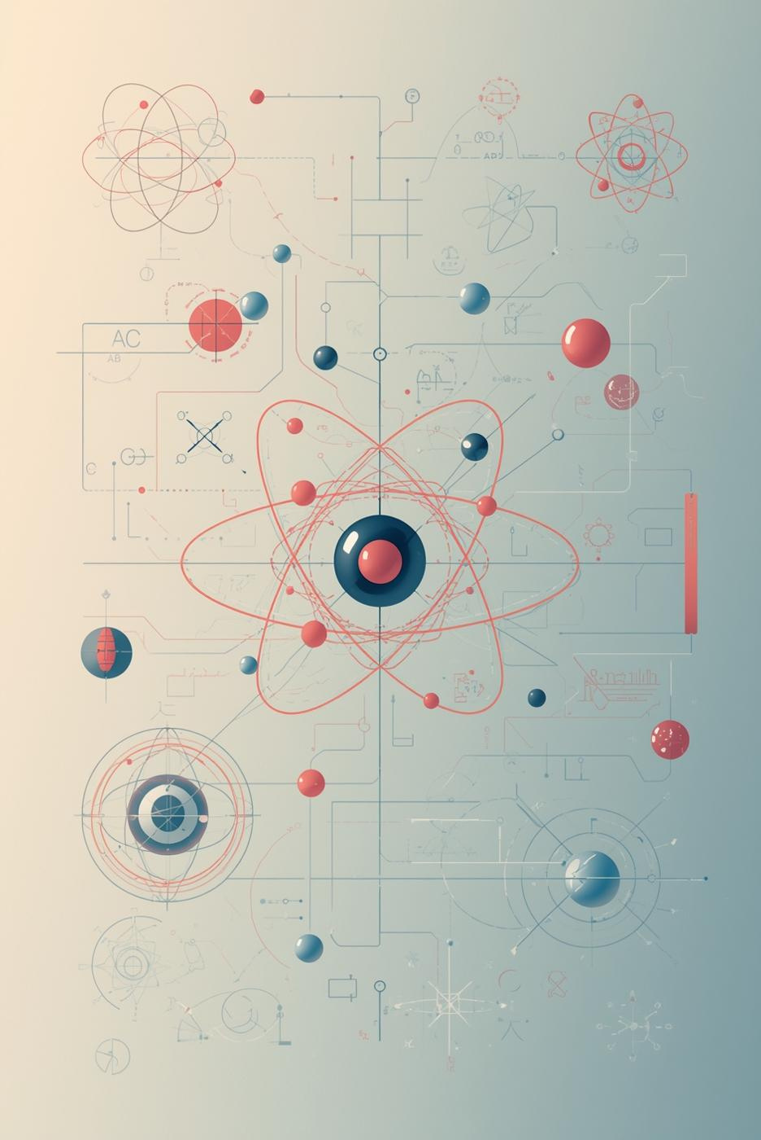
Atomic Theories and Particle Physics
Presenter: Abdul Subhan
roll no: 25F-CY-063

Slide 2

Agenda
Atomic Theories
Particle Physics
Early models
Modern theories
Subatomic particles
Fundamental forces

Slide 3

Atomic Models
Dalton
Thomson
Rutherford
Bohr
Solid sphere model of atoms
Plum pudding model of electrons
Nuclear model with dense nucleus
Quantized orbits of electrons

Slide 4
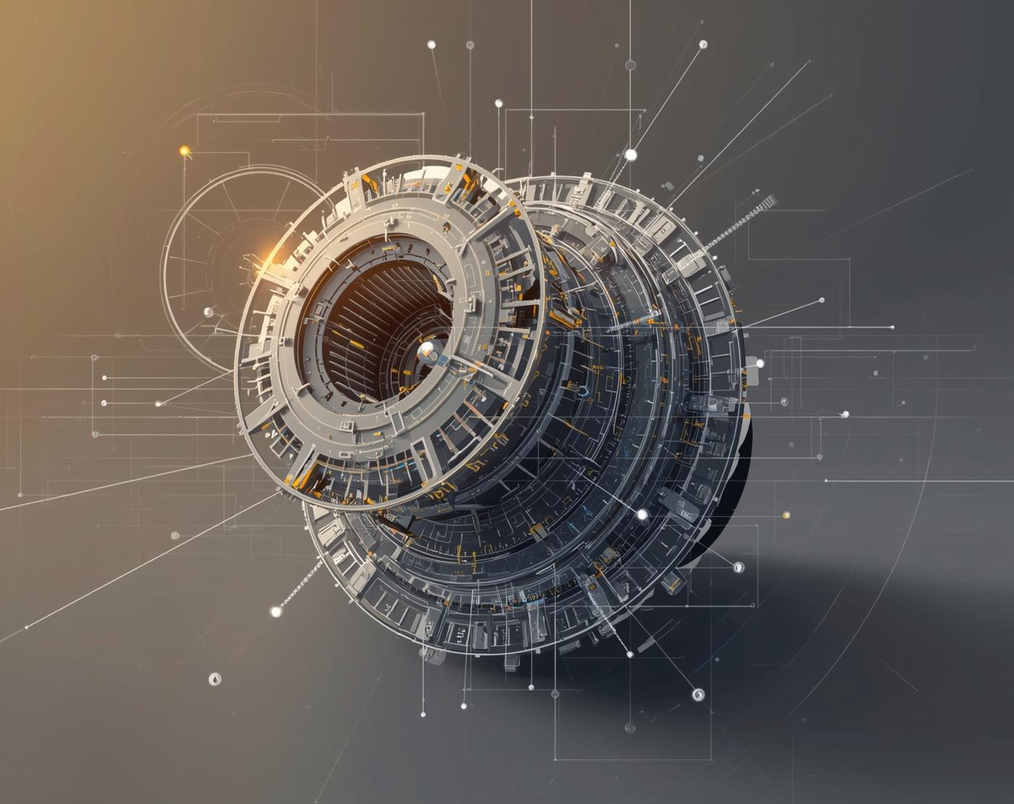
Understanding Particle Physics
Exploring the Building Blocks of Matter
Particle physics studies fundamental particles and their interactions.

Slide 5
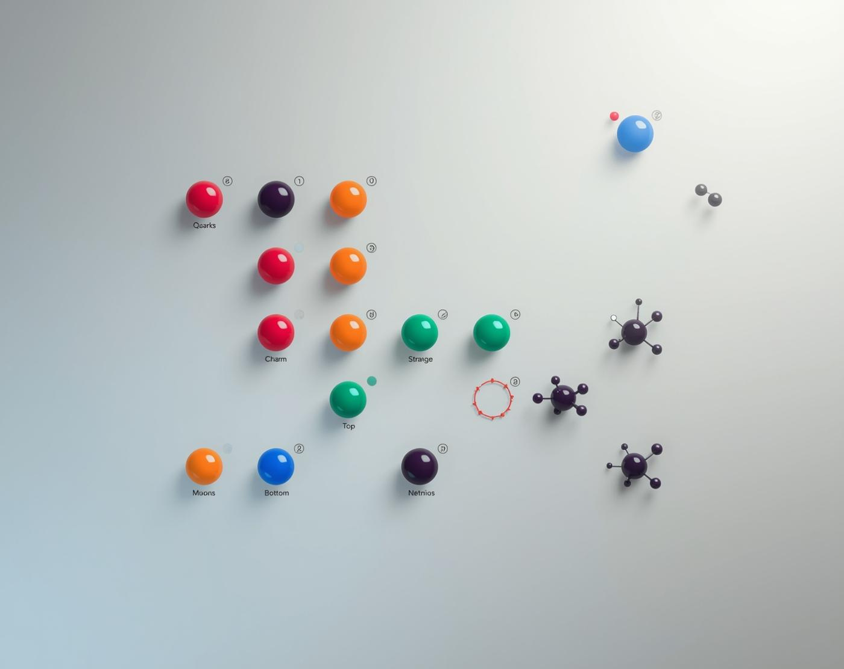
Quarks and Leptons
Fundamental Building Blocks of Matter
The essence of matter lies in these particles

Slide 6
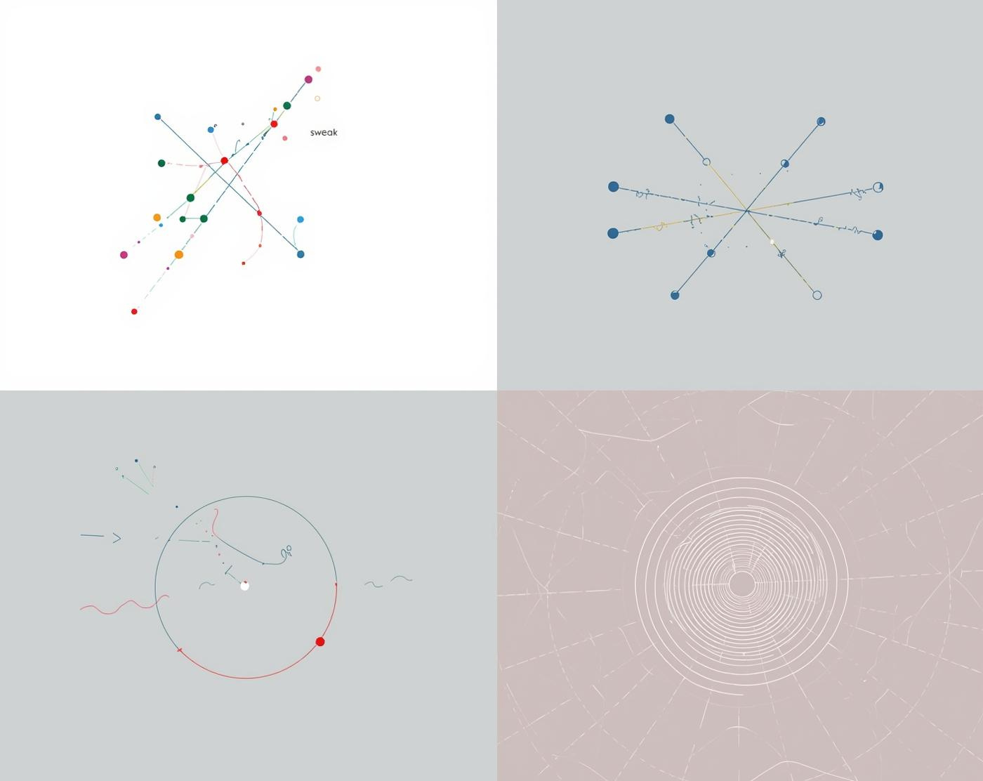
Fundamental Forces of Nature
Understanding the interactions that govern matter
Strong, weak, electromagnetic, and gravitational forces

Slide 7
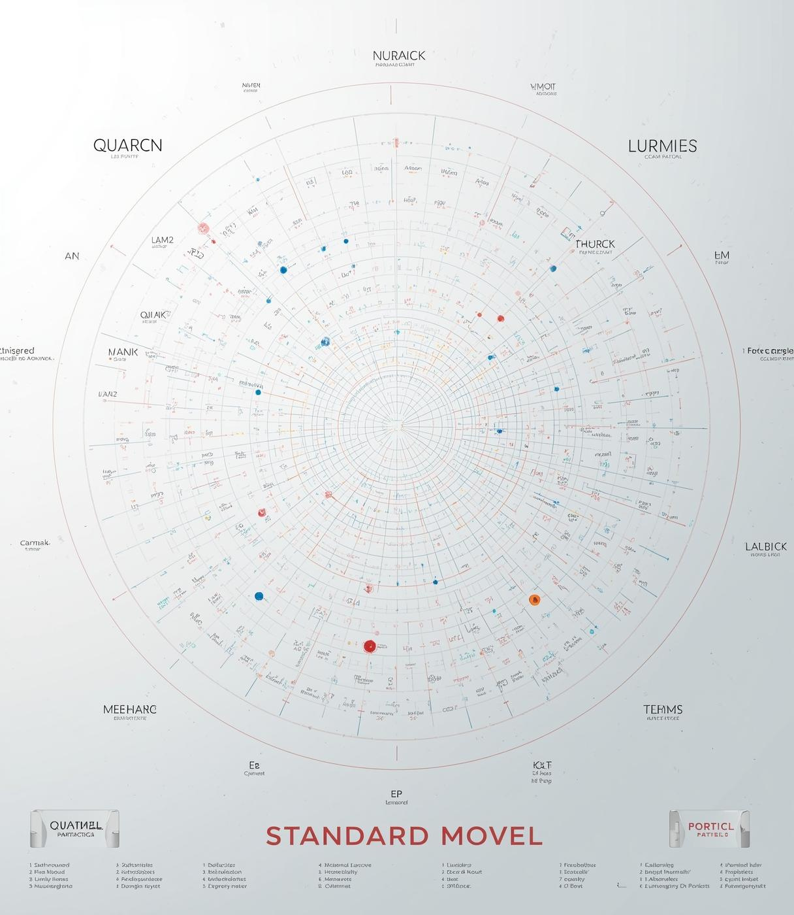
The Standard Model
Framework for understanding fundamental particles and forces

Slide 8
Quarks and Leptons
Up
Down
Charm
Strange
First generation quark type
Second generation quark type
Third generation quark type
Fourth generation quark type

Slide 9
Force Carriers
Photons
Gluons
W and Z
Higgs Boson
Light particles that carry electromagnetic force
Hold quarks together through strong force
Mediators of weak nuclear interactions
Gives mass to other fundamental particles

Slide 10
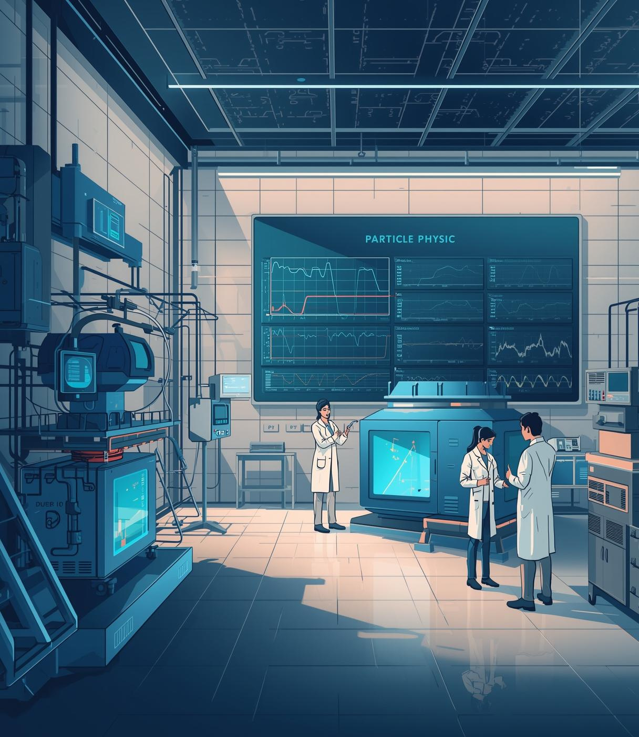
Standard Model Insights
Achievements and challenges in particle physics

Slide 11
Connections
Structure
Forces
Atomic structure is fundamentally linked to the behavior of subatomic particles.
The interactions between particles are governed by four fundamental forces in nature.

Slide 12
Applications
Imaging
Accelerators
Technology
Energy
Enhances diagnostic accuracy in healthcare.
Powers particle physics experiments and research.
Fuels advancements in material science.
Supports clean energy solutions and innovations.

Slide 13
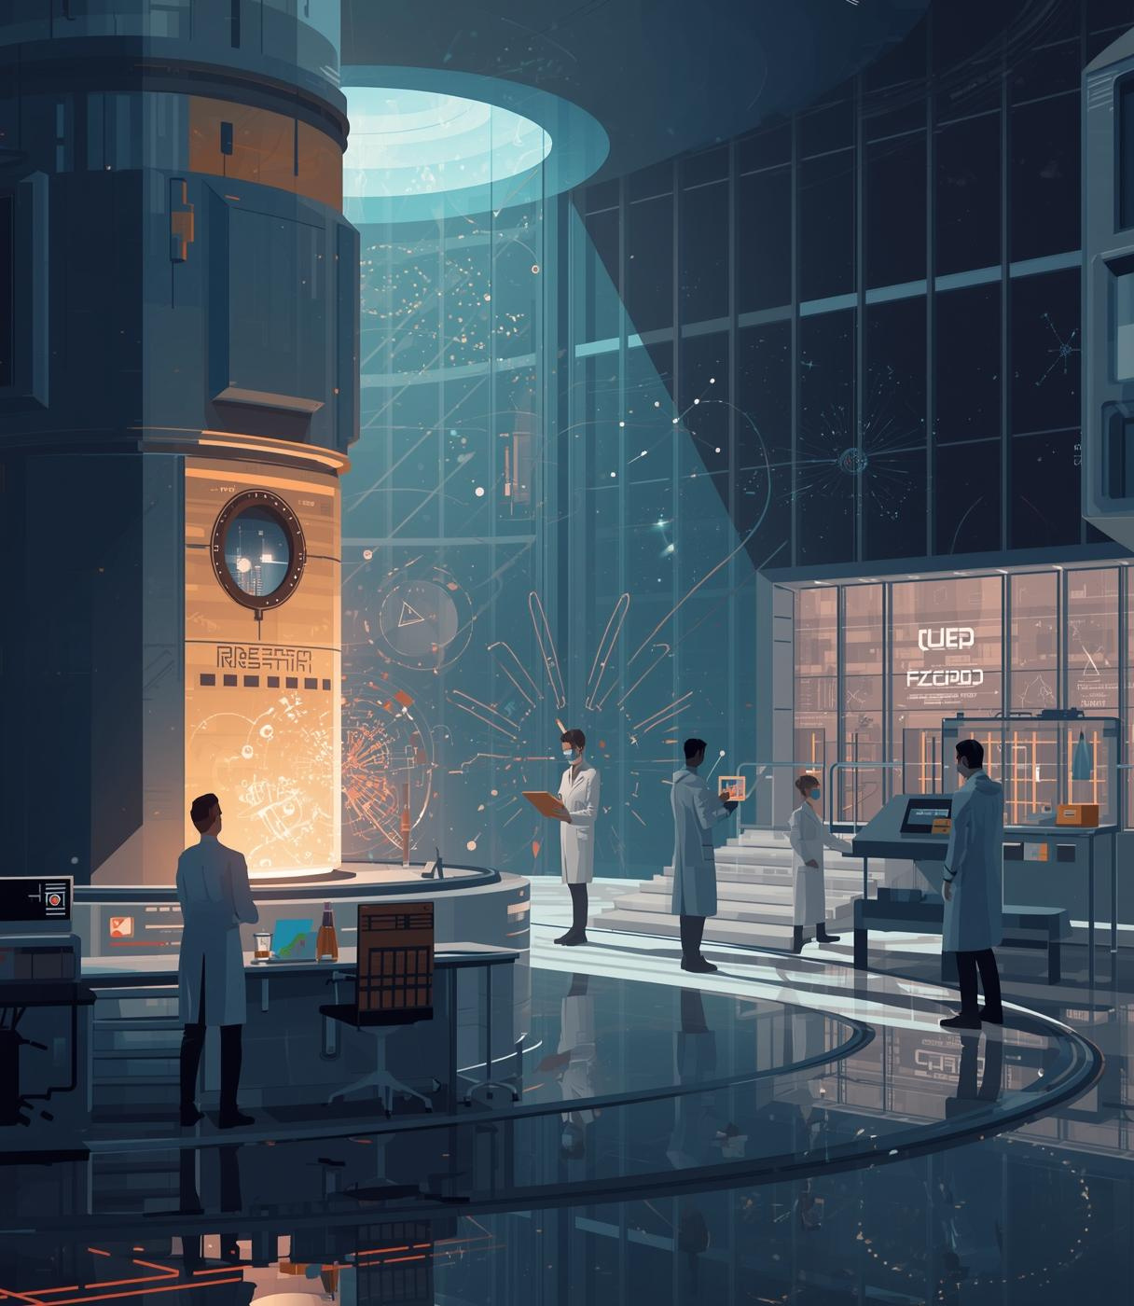
Research Beyond the Standard Model
Exploring the frontiers of particle physics and theories

Slide 14
Summary
Atomic Theories
Particle Physics
Historical models
Modern quantum theory
Subatomic particles
Fundamental forces

Slide 15
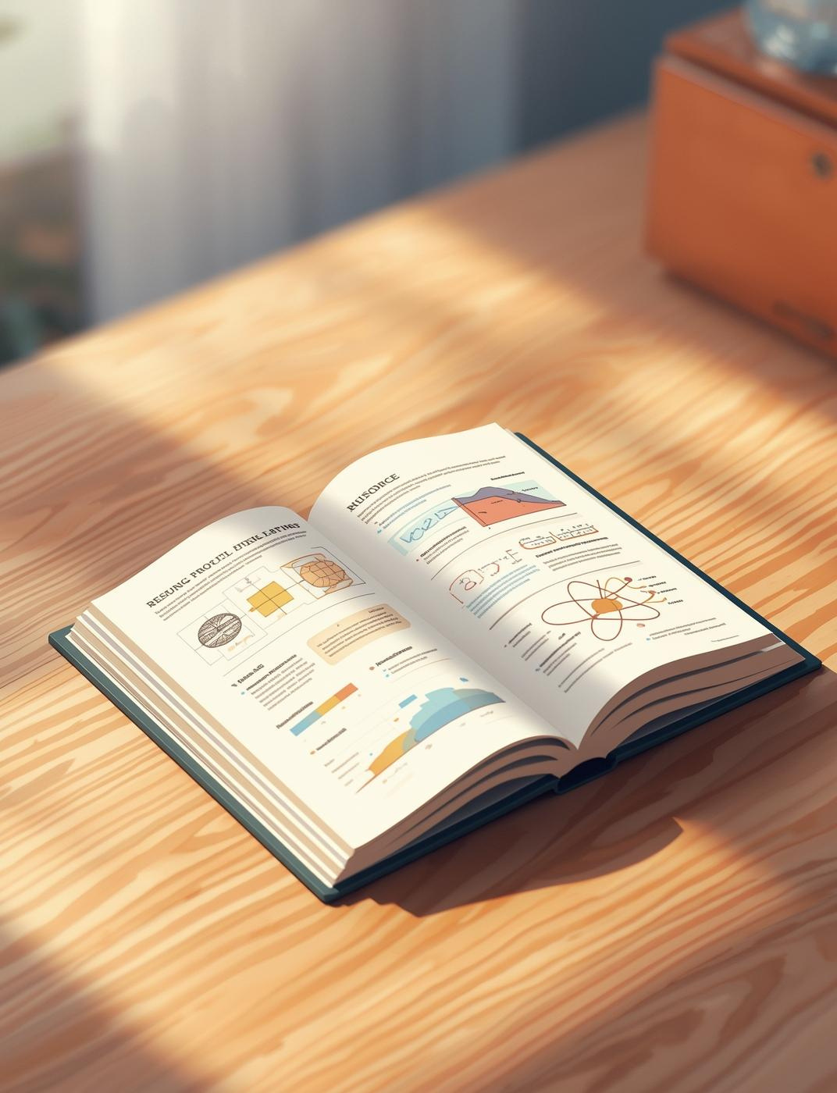
Resources
Books, articles, and videos

Slide 16
Thank You for Your Attention

